Slide 1
OS Concept Map 5 – May 17
Agenda
Module A.6 OS Concept Map
Discussion: Topic E – Utilities
Discussion: Topic F – File Systems
Catch-Up
See Spreadsheet for Missing / Incomplete Work
Upcoming
Tue, May 21st : OS Concept Map Due
Tue, May 21st : Quiz on OS Concepts

Slide 3
Topic E - Utilities
Example Utilities:
Disk Defragmentation
File Shredder

Slide 4
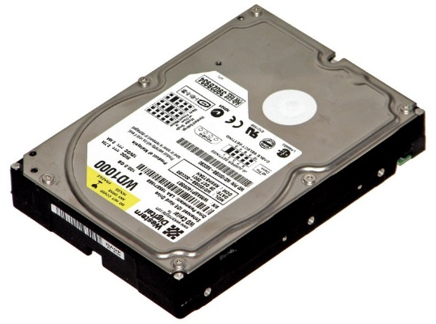
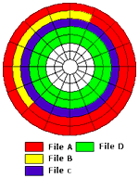
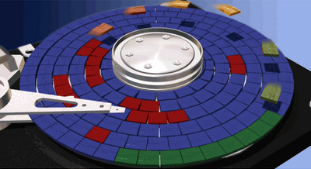
Disk Defragmentation
Files are written in blocks (Chunks)
Large files can require 100s of blocks
These blocks can be written anywhere on the disk

Slide 5
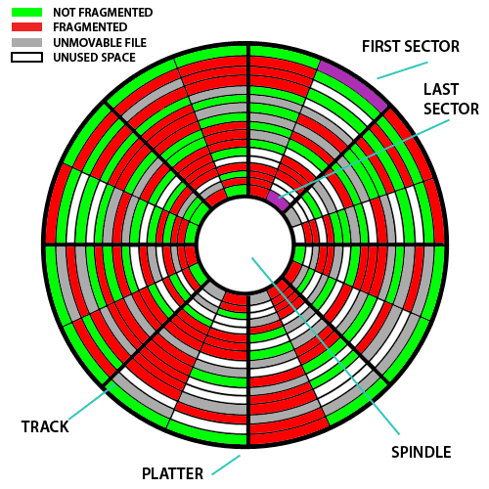
Disk Defragmentation
Fast and Efficient File Access
File blocks are close together
Disk hardware can read blocks sequentially
Over Time Disk Becomes Fragmented
File blocks are spread apart
Disk hardware must spend a lot of time hunting for blocks
File access is slow and inefficient
Periodic use of the Defragmentation Tool can greatly speed up your computer!

Slide 6
Fragmented Disk
Files are written to a disk in chunks called “sectors”
A large file may be composed of many sectors
The sectors used for a file do not need to be next to each other
However, it is more efficient if the file sectors are next to each other.
Over time, file sectors can get scattered all over a disk.
The file contents is not affected by this condition.
However, it becomes very slow to read and write these files.
The disk has to spend a lot of time moving its magnetic sensors and looking for different sectors.
This condition is called a “Fragmented Disk”

Slide 7
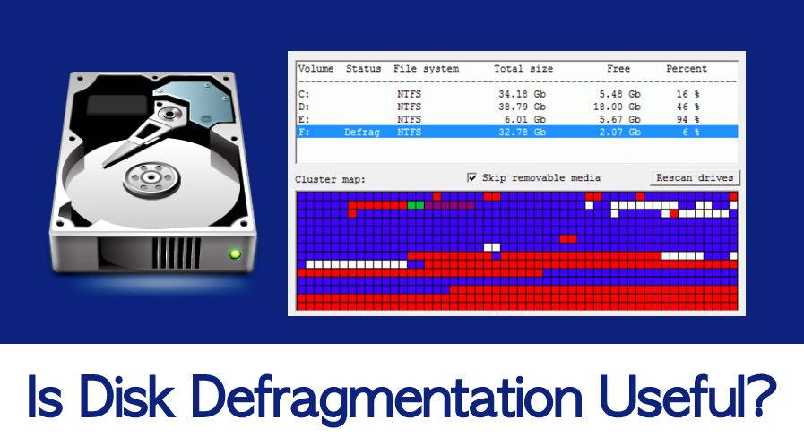
Defragmented Disk
The Defragmentation Tool restores a disk to a more efficient operating condition.
It reorganizes the disk so that all sectors in a file are next to each other.
It does this by cutting and pasting file sectors to move things around.
This process may take several hours for a large disk drive.
The Defragmentation Tool is found in in the System Utilities folder on Windows Systems
It should be used:
When your PC starts to run slowly
On a periodic basis for routine maintenance

Slide 8

File Shredding – Bonus Topic
When you delete a file, is it really deleted?
(Even when you empty the trash can)

Slide 9
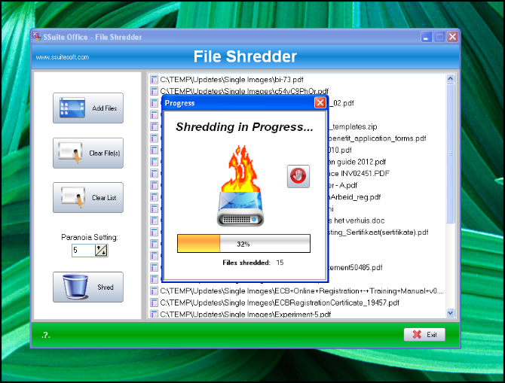
File Shredding – (to Rally Delete)
When a file is deleted:
Only the link to the first sector is deleted.
The sectors and file data is still stored as it was before the file was “deleted”.
The file sectors are only changed if / when they are needed for new files.
This makes file deletion on a Windows PC very fast and easy.
This means that “deleted” files:
Can be easily restored / recovered with the proper software tools.
Can be easily recovered by Police / Criminals
What you should do:
Install a 3rd party “File Shredder” application to make sure that data is totally erased / written over with a meaningless pattern.
Physically destroy your disk drives when you recycle your home PC.

Slide 10
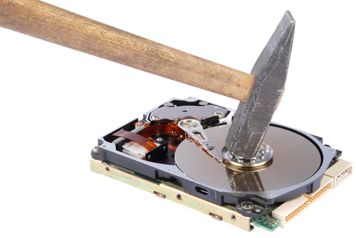
File Shredding – (to Rally Delete)
Using a File Shredder Utility is the only way to erase files from your disk.
Disk drives should be removed and destroyed when recycling a computer.

Slide 12
Topic F – File System & User Accounts
What are some things that a "File System" needs to keep track of?
Name of Files
Max File Name Length / Permissible Characters
Size of Files
Space on the memory device
Location of Files
Drives, Folders, & Sub-Folders
File Types
What files belong to different Applications
File Access & Ownership
Can anyone read or write any file?

Slide 13
File Names & File Sizes
Is there a maximum size for a name of a file?
Can you use any combination of keyboard characters in a file name?
Is there a limit on the maximum size of a file?

Slide 14
File Names & File Sizes
Different file systems have different limitations on:
The Character format and size of a file name
The Maximum size of a file
Examples for Windows OS
File System | Windows Version | Max Name Size | Max File Size
NTFS | Current | 255 Characters | 2⁶⁴ Bytes
FAT32 | Late 1990's | 255 Characters | 4 Gigabytes
FAT16 | Early Versions | 127 Characters | 2 Gigabytes

Slide 15
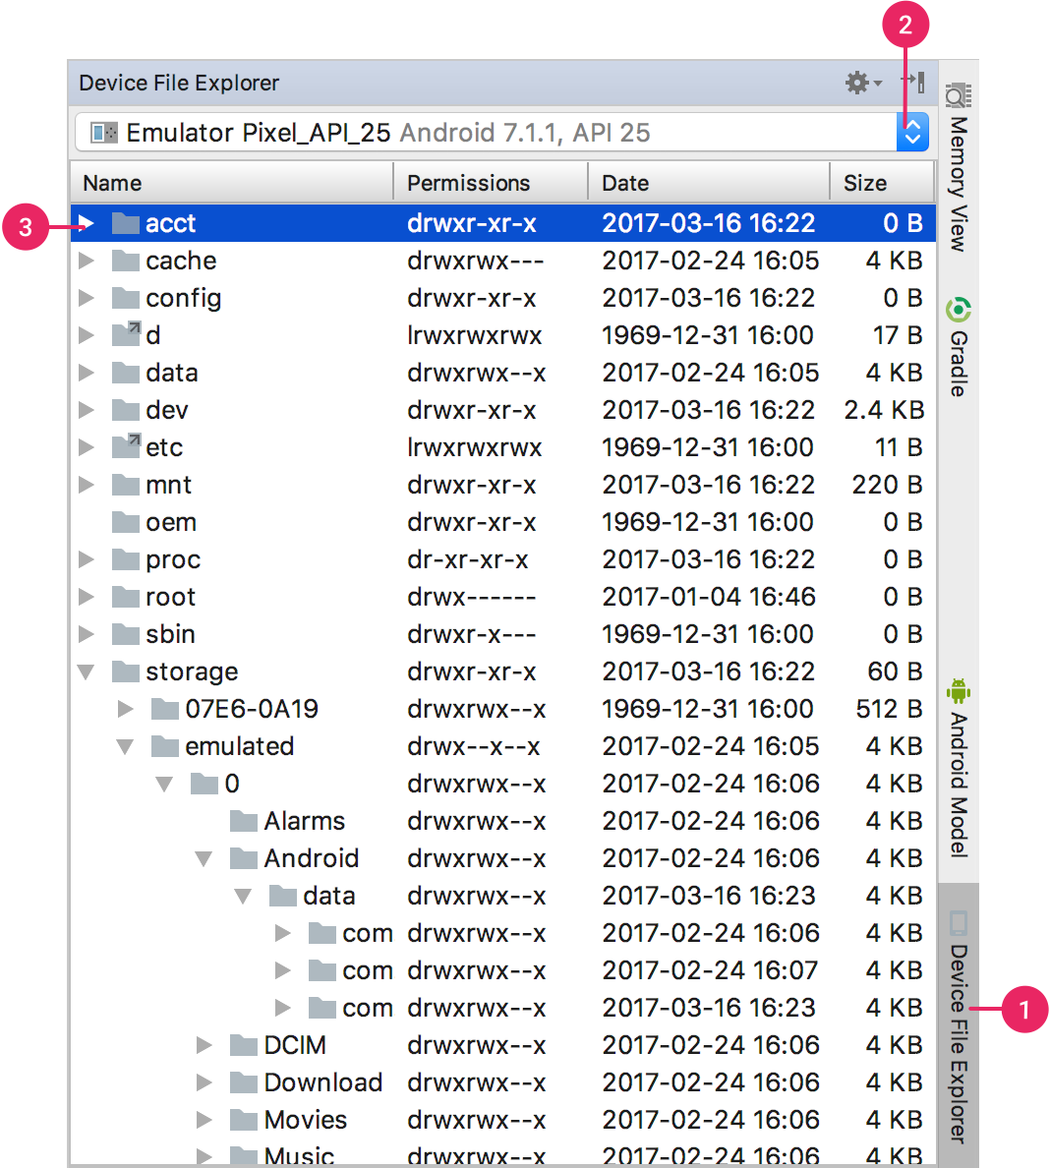
Location of Files
Operating Systems Provide and Maintain:
A Visual Representation
Files
Folders
Drives (Devices)
Networks
A Physical Map
Also Known as a Directory
A Numerical List of the: Location, Name, and Size of everything stored ion the computer

Slide 16
File Types & Extensions
How can the file system tell the difference between Binary Files & Text Files?
How can the file system tell what Application to use for different files?

Slide 17
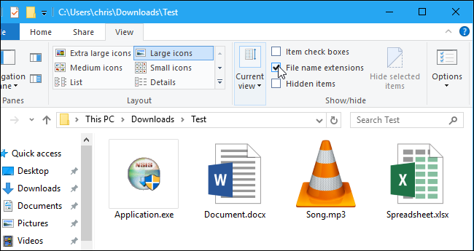
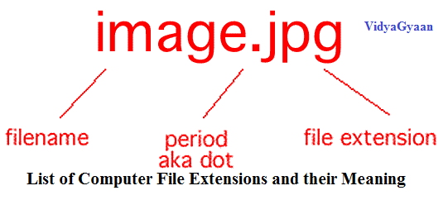
File Types & Extensions
Windows uses the "file extension" part of the file name to identify different types of files.
".doc" is a text editing format
".jpg" is an image file format
Applications may register with the Operating System to become associated with file extensions.
MS Word is the registered "owner" of ".doc" files
Either Paint or Photoshop may open ".jpg" files

Slide 18
File Access & Ownership
Would you want just anybody to be able to read and modify your files?
How about protecting yourself from making mistakes with the files you own?

Slide 19
File Access & Ownership
Operating Systems need to manage:
Different Local Users
Network Users & Accounts
File Access Privileges
File Access Privileges Include:
Who Owns The File
Is it Private or Public
Who can "read" the file
Who and "write/modify" the file
Who can "execute/run" the file
Linux Uses a 3 Level Ownership System
"d rwx rwx rwx" format
"user", "group", "world"
Windows is behind Linux in file permissions

Slide 21
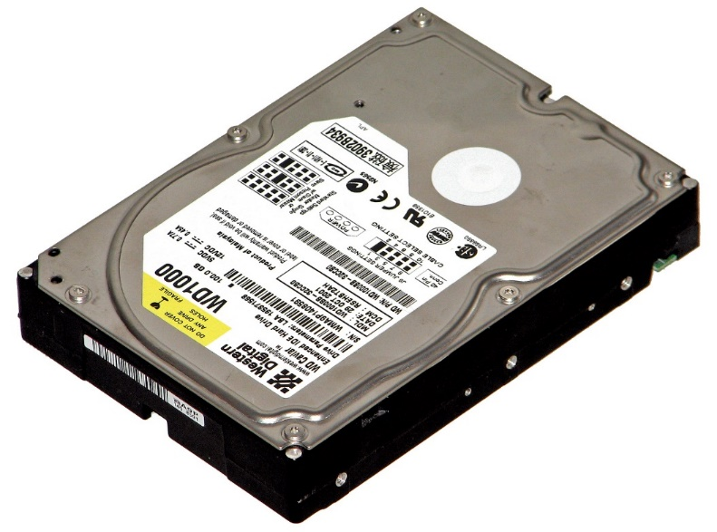
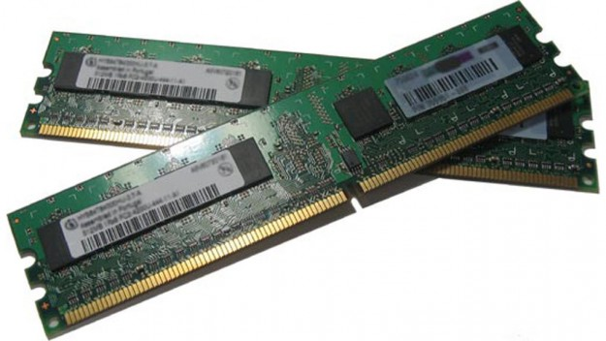
Memory Organization
Computer Architecture

Slide 22
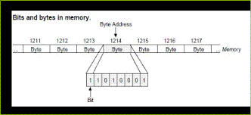
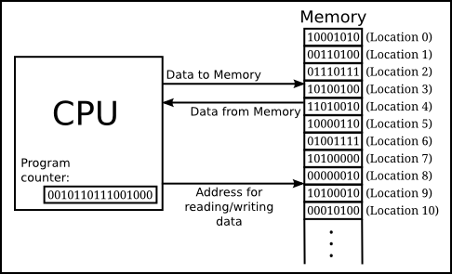
Main Memory (e.g. RAM)
Main Memory
Main
Data
Storage
(0.5–4 Gb)
Program
Storage
(0.5–4 Gb)
High Speed
Memory Bus
Central
Processor
Motherboard

Slide 23
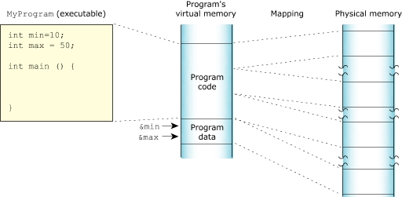

Slide 24
External Memory (e.g. Hard Disk Drive)
Main Memory
Main
Data
Storage
Program
Storage
IDE or SATA
Cable Interface (Slower Speed)
Data
&
Program
Storage (0.5-4 Tb)
High Speed
Memory Bus
Central
Processor
External Memory
Motherboard

Slide 25
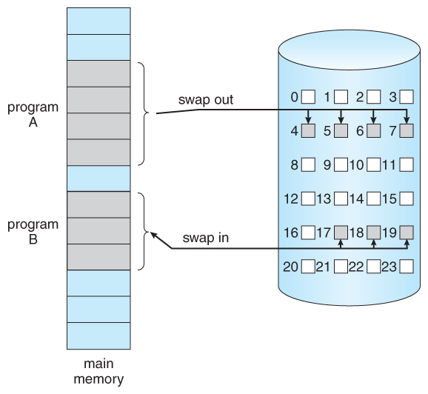

Slide 26
Cache Memory
Main Memory
Main
Data
Storage
Program
Storage
Data
&
Program
Storage (0.5-4 Tb)
Cache
Cache Features:
Extreme High Speed
Small Size (512 Mb)
Buffer
Pre-fetch
Cache
Central
Processor
External Memory
Motherboard

Slide 28
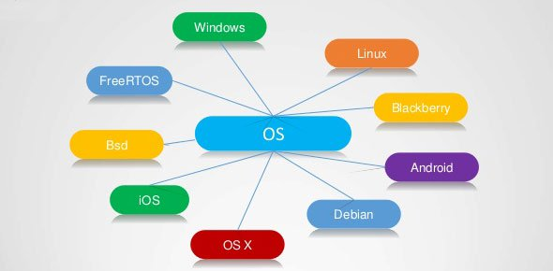

Slide 29
Topic A – Application & OS Layers
Computer Organization (Layers)
Hardware Layer
CPU
RAM
Memory
Display
Mouse /
Keyboard
DISKS

Slide 30
Topic A – Application & OS Layers
Computer Organization (Layers)
Application
(Program) Layer
MS Word
(Office)
Chrome
(Web)
Photoshop
(Media)
Other Apps
Hardware Layer
CPU
RAM
Memory
Display
Mouse /
Keyboard
DISKS

Slide 31
Topic A – Application & OS Layers
Computer Organization (Layers)
Application
(Program) Layer
MS Word
(Office)
Chrome
(Web)
Photoshop
(Media)
Other Apps
High End Game
Operating
System Layer
(Software)
Task
Scheduler
Memory
Allocation
Device
Manager
Display Control
I/O Interrupts
Hardware Layer
CPU
RAM
Memory
Display
Mouse /
Keyboard
DISKS

Slide 32
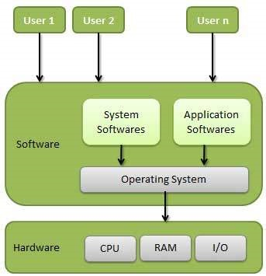
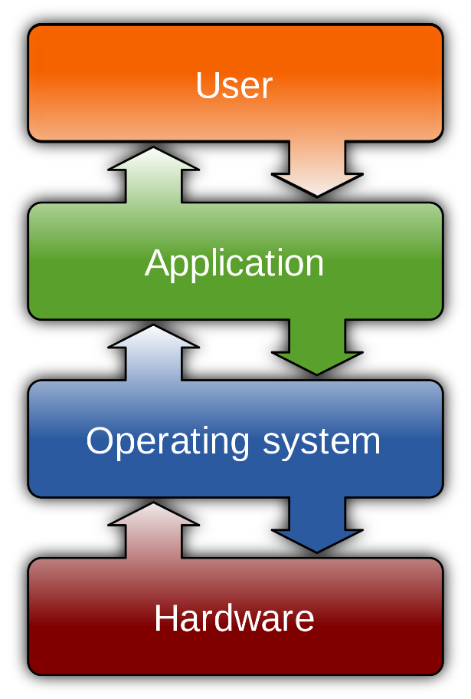

Slide 33
Topic A – Application & OS Layers
Common Computer Tasks (Operations)
E.g. Open A Program
Application
(Program) Layer
MS Word
(Office)
Chrome
(Web)
Photoshop
(Media)
Other Apps
Operating
System Layer
(Software)
Task
Scheduler
Memory
Allocation
Device
Manager
Display Control
I/O Interrupts
Hardware Layer
CPU
RAM
Memory
Display
Mouse /
Keyboard
DISKS

Slide 34
Topic A – Application & OS Layers
Common Computer Tasks (Operations)
E.g. Open A Program
Application
(Program) Layer
MS Word
(Office)
Chrome
(Web)
Photoshop
(Media)
Other Apps
Operating
System Layer
(Software)
Task
Scheduler
Memory
Allocation
Device
Manager
Display Control
I/O Interrupts
Hardware Layer
CPU
RAM
Memory
Display
Mouse /
Keyboard
DISKS

Slide 35
Topic A – Application & OS Layers
Common Computer Tasks (Operations)
E.g. Typing Some Text
Application
(Program) Layer
MS Word
(Office)
Chrome
(Web)
Photoshop
(Media)
Other Apps
Operating
System Layer
(Software)
Task
Scheduler
Memory
Allocation
Device
Manager
Display Control
I/O Interrupts
Hardware Layer
CPU
RAM
Memory
Display
Mouse /
Keyboard
DISKS

Slide 36
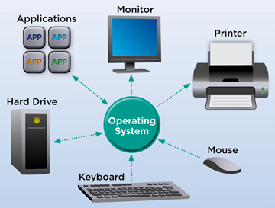

Slide 38
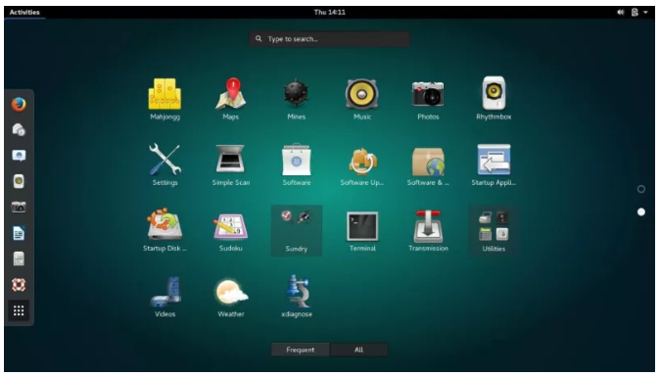

Slide 39
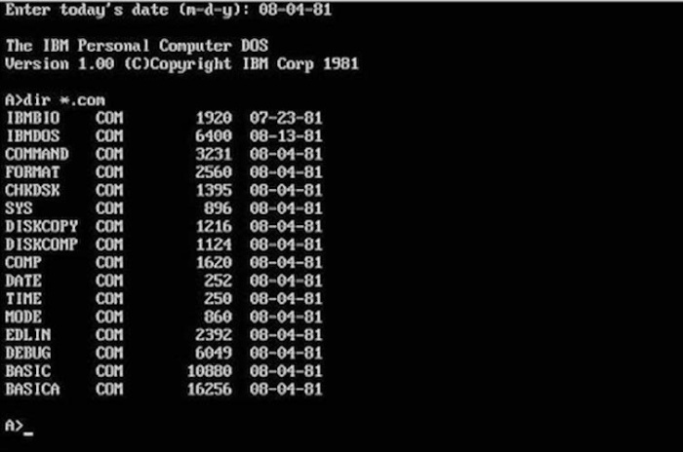
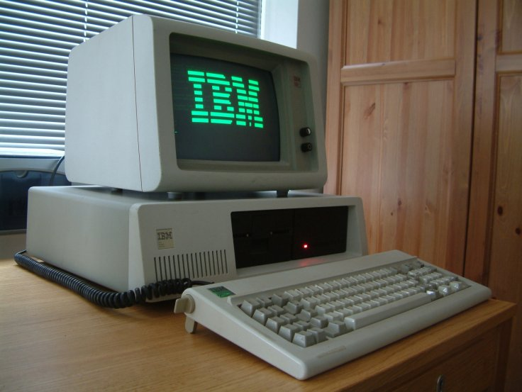
Topic B – Window Interface
Early Computers (DOS Based)
Command Line (Console)
One Program At A Time
Full Screen Display
No Mouse

Slide 40
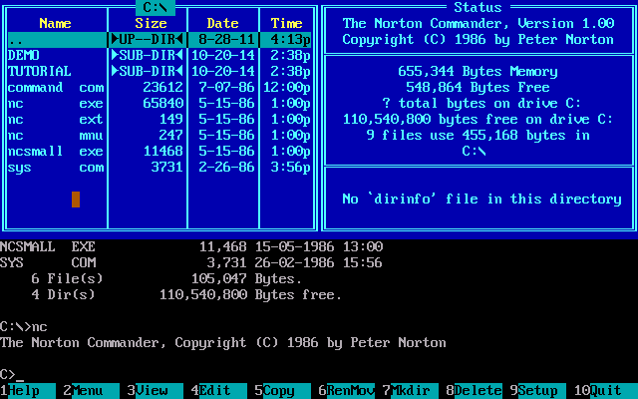
Topic B – Window Interface
Norton Commander / DOS Shell
Runs as a “Shell” on top of DOS
Still Full Screen / Text Based (No Mouse)
Still One Program At A Time
Added the Ideas of:
Menu Items
Hot Keys
Visual Organization
Improved the:
management of files
Speed of accessing and opening applications

Slide 41
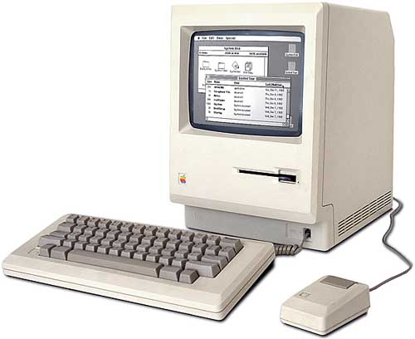
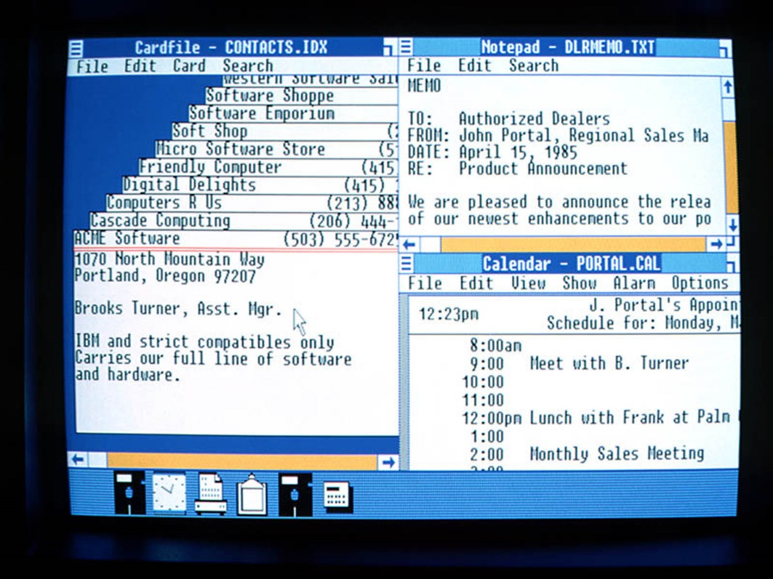
Topic B – Window Interface
Windows 1.0 / Macintosh (1985)
First mouse based interface
Applications open in own window
Widgets / Dialogues / Drop Down Menus
Many Program At A Time
Icons!
Trash Can!

Slide 42
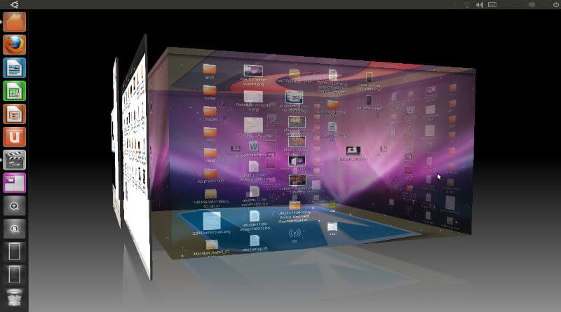
Topic B – Window Interface
Modern Graphical User Interface (GUI)
Multiple Workspaces / Accelerated Graphics
Touch Screen Interface
Network
Wide Reach

Slide 44
Assignment Overview
Objective:
To learn about the key parts of a software operating system (OS)
Process:
Level 1 : Rough Research
Level 2 : Organized Research
Level 3 : Final Concept Map
OS Topics:
Windows
Mac OS
Linux
Android
iOS

Slide 45
Important To Do
I will be marking the PROCESS as well as the PRODUCT.
Level 1 : Rough Research
I need to see content in this area!!!
Cut and paste rough research notes as you go.
Level 2 : Organized Research
I need to see stuff from Level 1 appear here!!!
Organise your rough research into common ideas
Reduce duplicated information
Re-word into your own voice
Level 3 : Concept Map
Select only the most important stuff from Level 2
Summarize into short bullet points
You will be MARKED DOWN if concept map is rust a repeat of Level 2

Slide 46
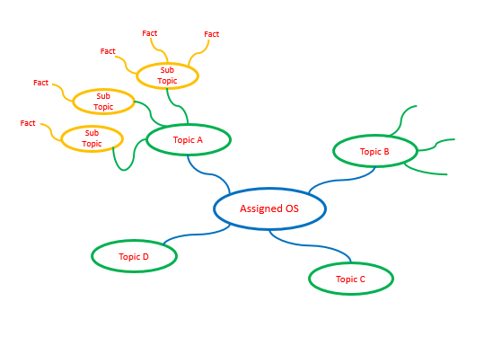
Concept Map
Use PowerPoint or another application of your choice.
Submit as PDF or Image File

